Slide 1

Application of AR in Industry
Indian Institute of Technology, Bombay
Under the guidance of
Prof. Jayendran Venkateswaran
Industrial Engineering & Operations Research
Presented by
Aakash Roy
21i170007

Slide 2
Outline of Todays Presentation
01
02
04
05
What is Augmented Reality
Brief Literature Survey
03
Application Development
Problem statement
Framework
Developing & importing 3D models
Adding CSS
Developing the Application
Developing the website
Deployment
Results & Discussion
Future Scopes
2/21

Slide 3
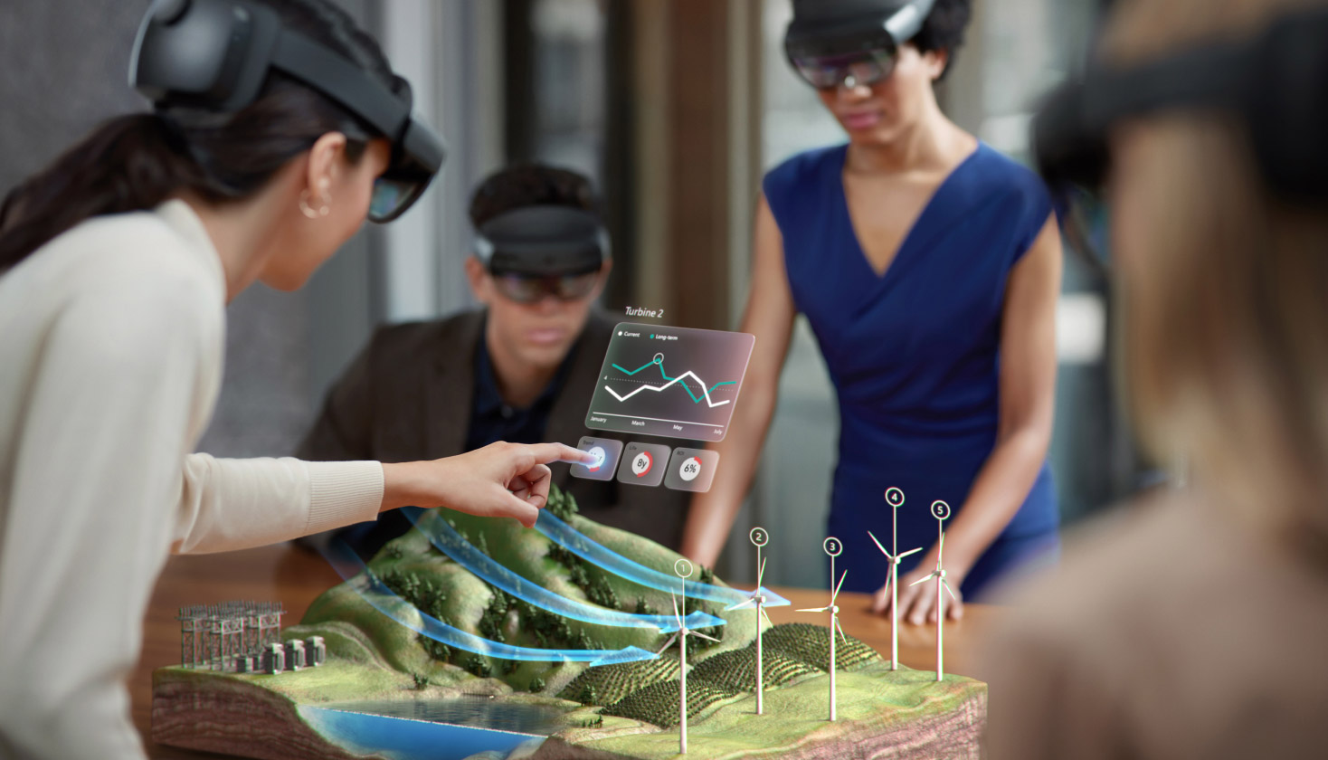
What is Augmented Reality?
Interactive version of a real-world environment
Achieved through digital visual elements, sounds, and other sensory stimuli via holographic technology
AR incorporates three features: a combination of digital and physical worlds, interactions made in real time, and accurate 3D identification of virtual and real objects.
Then, what about AR vs. virtual reality vs. mixed reality ??
Source: https://dynamics.microsoft.com/
3/21

Slide 4
Literature Survey
HTML+ CSS
JavaScript
ARCore
WebGL
Three.js
WebXR
HTML: Language for describing the structure of Web pages
CSS: Language for describing the presentation of Web pages
Language to make websites interactive
Platform for Augmented Reality design and deployment
API for rendering high-performance interactive 3D and 2D graphics
JS library used to display the graphics, 3D and 2D objects on the web
API needed to bring both augmented and virtual reality (AR and VR) to the web
Gyro & Accelerometer
Magnetic Sensor
GPS + Camera
Provides direction based data
GPS: Provides location based data
Camera: Helps to see the real world
Senses the angular velocity.
4/21

Slide 5
HTML & CSS
HTML
HTML gives the flexibility to Publish online documents with headings, text, tables, lists, photos, etc.
Retrieve online information via hypertext links, at the click of a button
Designed for conducting transactions with remote services, for use in searching for information
CSS
CSS is the language for describing the presentation of Web pages, including colors, layout and fonts.
Independent of HTML and can be used with any XML-based markup language.
The separation of HTML from CSS makes it easier to maintain sites, share style sheets across pages, and tailor pages to different environments.
5/21

Slide 6
Java Script
JavaScript allows you to make your website interactive
It allows for all the content you created with HTML and styled with CSS to become more engaging
JavaScript is what turns your website from a wall of text into an experience.
Practical applications of JavaScript are almost endless eg. Interactive Websites, Video games, Web Mobile apps.
6/21

Slide 7
AR Core
Developer platform for Augmented Reality design and deployment
With this SDK users’ phones are able to sense the external environment
Supports both Android and iOS devices
Comes with 3 core capabilities to merge virtual and real worlds: a. Motion tracking – to track phone’s position relative to the surroundings b. Environmental understanding – to detect the size/location of surfaces, from horizontal and vertical, to even angled surfaces. c. Light estimation – to estimate the real-life lighting conditions.
7/21

Slide 8
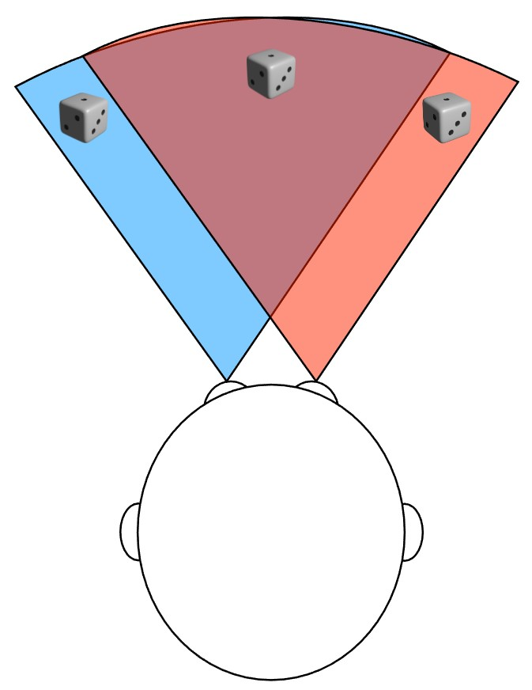
WebXR
WebXR Device API at its core, provides the functionality needed to bring both augmented and virtual reality (AR and VR) to the web.
Before getting into too much detail, let’s consider some basic concepts that we need to know before developing XR code.. A. Field of view It is the extent to which we are able to see the environment. The width of FOV is specified either in degrees or radians, measured as the angle defining the arc from the far left edge of our FOV to the far right edge
Source: https://developer.mozilla.org/en-US/docs/Web/API/WebXR Device API
8/21

Slide 9
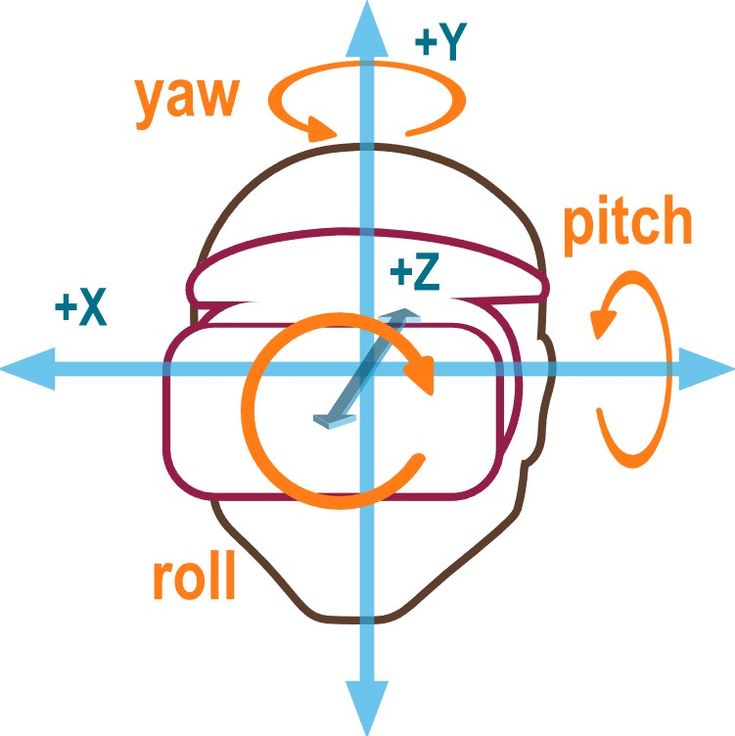
WebXR
Degrees of freedom
It is an indication of how much freedom of movement the user has within the virtual world i.e. how many types of movement the WebXR hardware configuration is capable of recognizing and reproducing into the virtual scene
Freedom of translational movement
This provides the ability to sense movement
through space: forward and backward, left and right, up and down
WebXR session modes
WebXR offers support for both augmented reality (AR) and virtual reality (VR) sessions, using the same API
Source: https://developer.mozilla.org/en-US/docs/Web/API/WebXR Device API
9/21

Slide 10
WebGL
It is a JavaScript API for rendering high-performance interactive 3D and 2D graphics within any compatible web browser without the use of plug-ins
It does so by introducing an API that closely conforms to OpenGL ES 2.0 that can be used in HTML canvas. elements.
This conformance makes it possible for the API to take advantage of hardware graphics acceleration provided by the user’s device.
10/21

Slide 11
Three.js
It is an open source JavaScript library that is used to display the graphics, 3D and 2D objects on the web browser
It uses WebGL API behind the scene
It allow us to use your GPU to render the Graphics and 3D objects on a canvas in the web browser
And since we are using JavaScript so we can also interact with other HTML elements
WebGL for Graphics then it doesn’t support most of the browser but Three.js supports most of the browsers
It doesn’t required any third party plugin to run the code
11/21

Slide 12
Hardware
Gyroscope & Accelerometer Senses angular velocity which is used to track the rotational movements of pitch, yaw, and roll which is an integral part of AR
Magnetic Sensor Without a Compass, an Augmented Reality app cannot display information accurately, as it won’t know which direction we are pointing to.
GPS Without accurate location tracking tools, such as GPS, your augmented reality experience would be quite rough
Camera Augmented reality starts with a camera-equipped devices. Without camera, we will not be able to see the real world which means, we can not project virtual objects into real world.
12/21

Slide 13
Application Development
Problem Statement
We want a program as follows:
Scans QR code provided on any machinery or book or any other object and shows all the necessary stats or models or related information
This will have implications in most of the industrial sectors because, it’s a very simple way to see through the world.
It’ll also help professionals working in the production industry, students in their education, companies for training purpose etc.
This also gives an extra dimension to see virtual things and analyze them.
Since, the future is based on cloud services, it’ll be easier to retrieve data from the cloud.
13/21

Slide 14




Application Development
Framework
Computer Vision
AR Experience
Industrial Robot
AR software connects with a 3-D digital facsimile of the object in the cloud
Data from sensors on the physical object streams to the cloud
The software retrieves information/data and the AR device superimposes it on the user’s view
The user interacts with the object by sending commands to the cloud through a touchscreen; by voice; or with gestures
Control commands such as ‘Stop’, ‘Start’,.. Are received by the cloud and sent to the object.
14/21

Slide 15
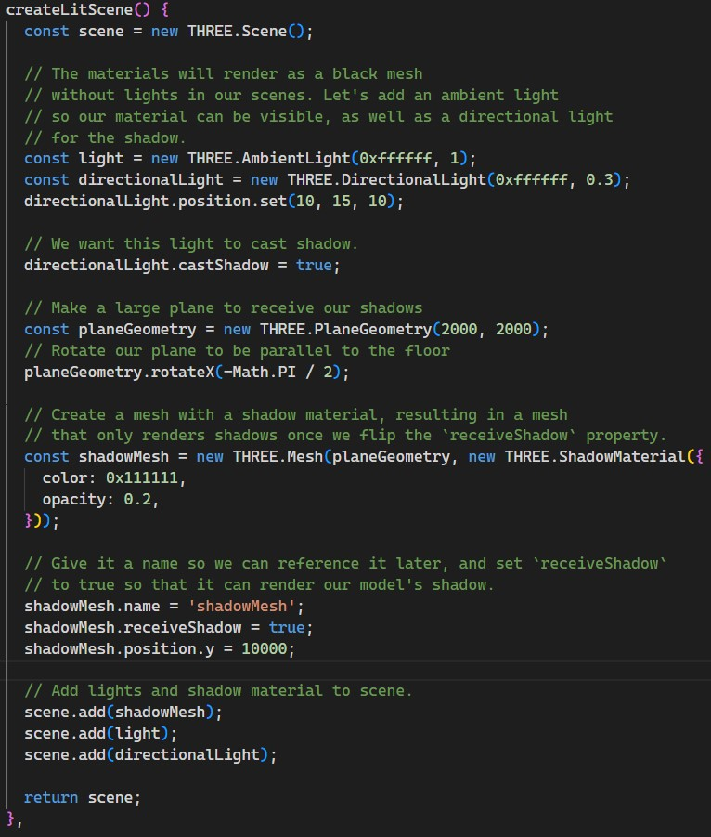
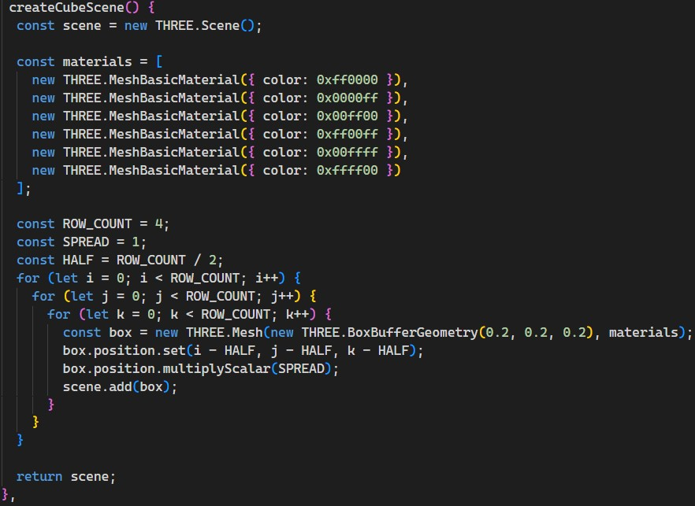
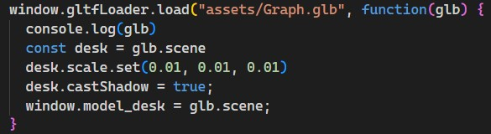
Application Development
Developing & Importing 3D Models
Creating Light 3D Scene
Creating 3D Scene
Importing 3D Scene
Adding CSS
15/21

Slide 16
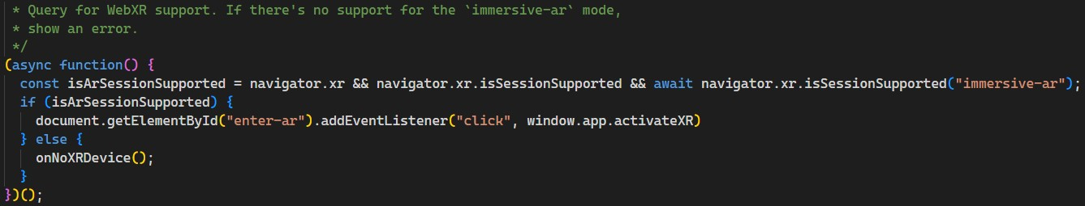
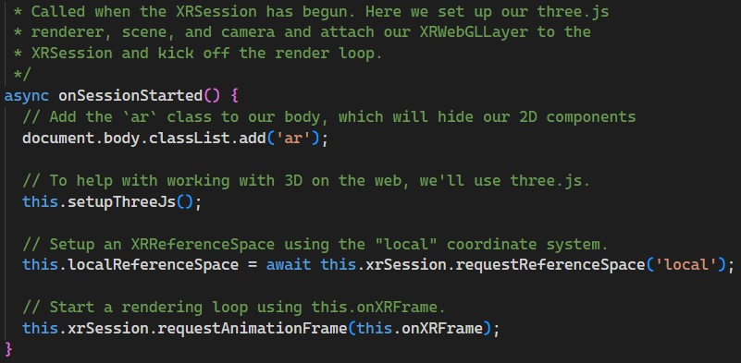
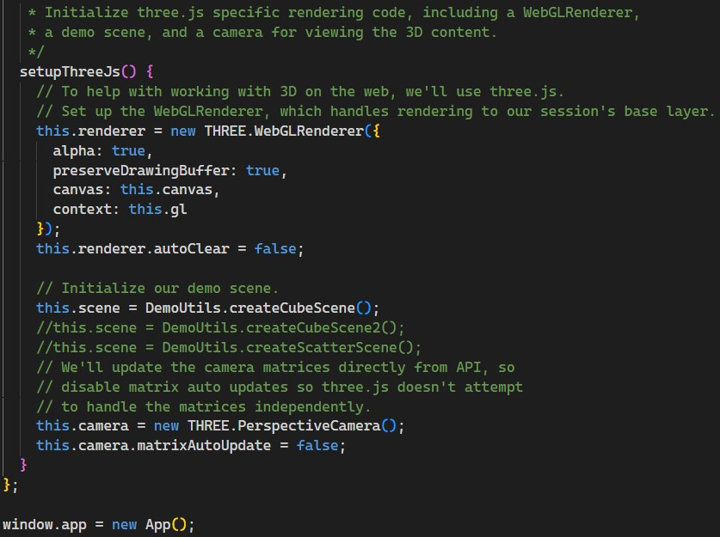
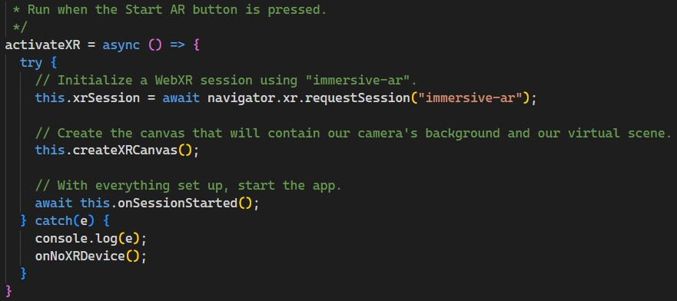
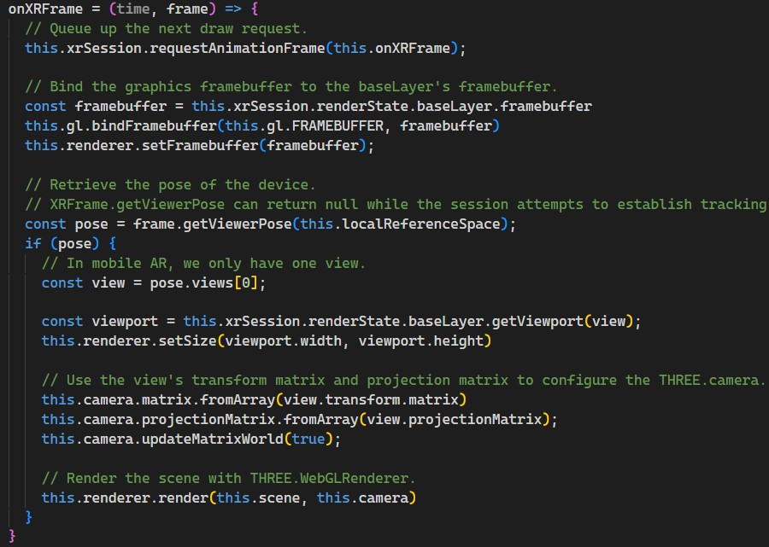
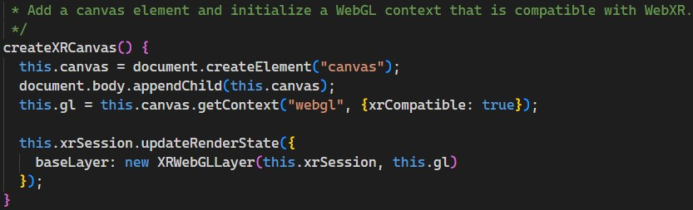
Application Development
Developing the application
Query for WebXR support
Run when the Start AR button is pressed
Add a canvas element and initialize a WebGL context
Add the `ar` class to our body, which will hide our 2D components
To help with working with 3D on the web, we'll use three.js
Start a rendering loop using this.onXRFrame
Initialize three.js specific rendering code, including a WebGLRenderer
16/21

Slide 17
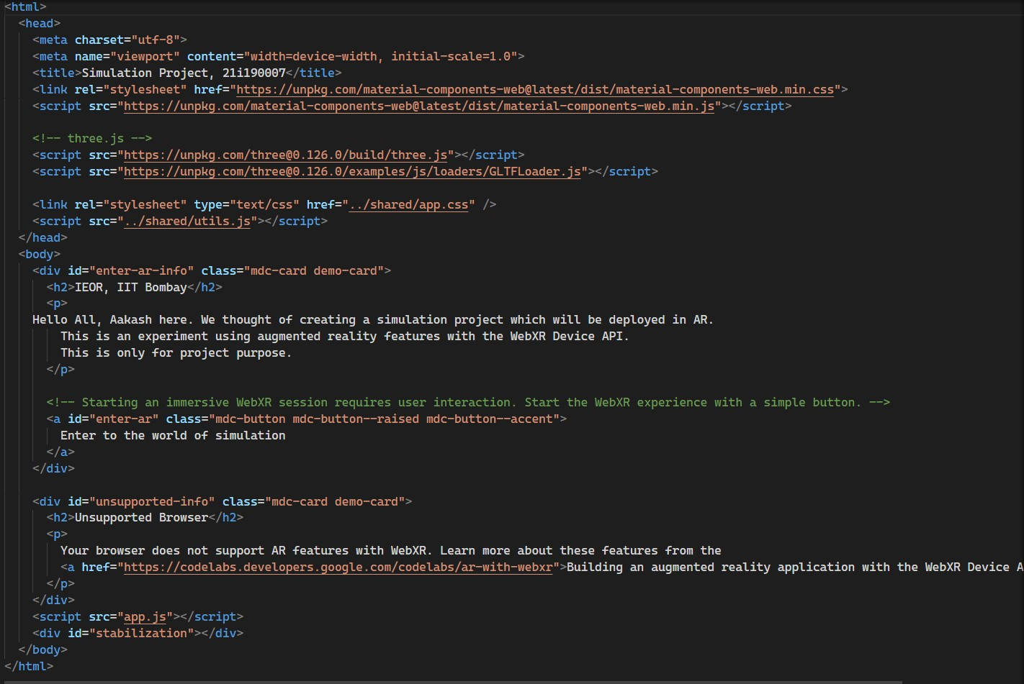
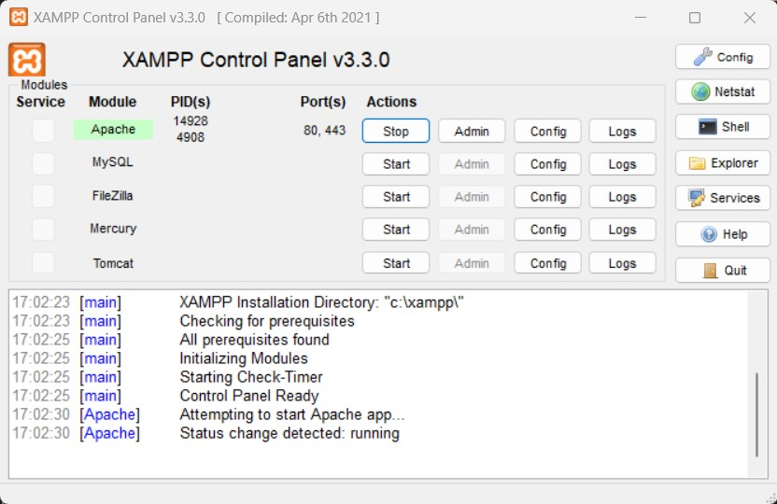
Application Development
Developing the website
Deployment
17/21

Slide 18
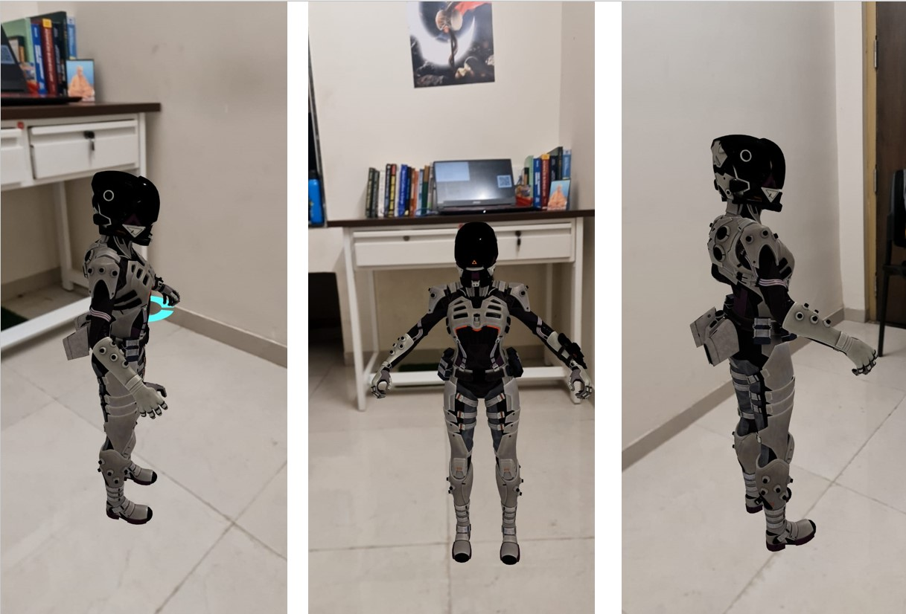
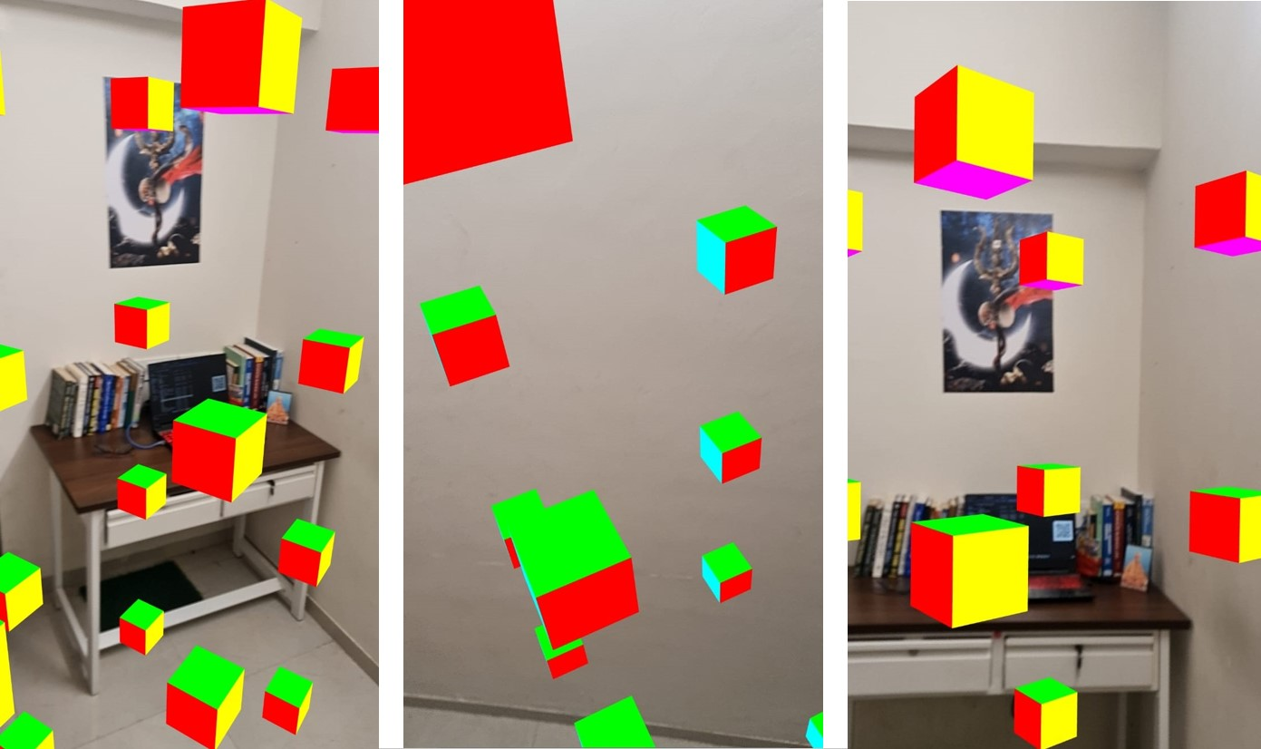
Results
Generated Cube Scene
Loaded .gltf file Scene
18/21
https://www.nature.com/articles/s41467-022-29118-6/figures/1

Slide 19
Future Scope
These technologies have started influencing human lives at its utmost potential. AR and VR will transform each and every aspect of the future that we all deal with such as travel & tourism, education, health care, movies & media, the environment, and more.
Meta (Better known as ) is also working on developing the AR and VR world so that people can play, learn and work more efficiently there which will open a new world for humans.
Our framework can be further improved and can be made open source so that, IITB people can add/create new models, logic around that and can make the learning resources for the future.
19/21
https://www.nature.com/articles/s41467-022-29118-6/figures/1

Slide 20
References
Siltanen, S. Texture generation over the marker area. In Proceedings of the ISMAR 2006: Fifth IEEE and ACM International Symposium on Mixed and Augmented Reality, Santa Barbara, CA, USA, 22–25 October 2006; pp. 253–254.
Meta Official Website. Available online: Click Here (accessed on 7 November 2020).
Augmented Reality in Industry 4.0 and Future Innovation Programs’, Gian Maria
Santi, Alessandro Ceruti, Alfredo Liverani and Francesco Osti
https://threejs.org/
https://arvr.google.com/arcore/
https://developer.mozilla.org/en-US/docs/Web/API/WebXR Device API
https://www.javatpoint.com/em-algorithm-in-machine-learning
https://www.geeksforgeeks.org
20/21
https://www.nature.com/articles/s41467-022-29118-6/figures/1

Slide 21
THANKS!
21/21

